Slide 1
Transfer Learning
October 2017

Slide 2
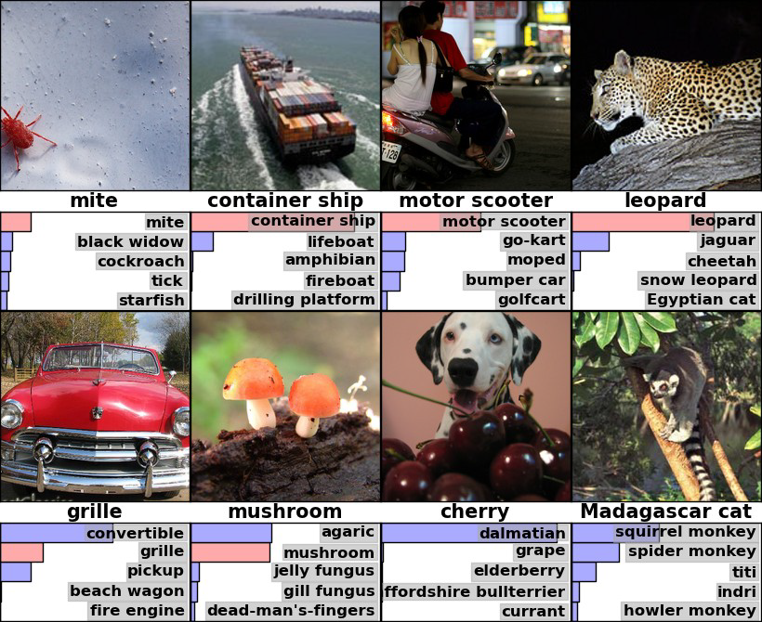
Image Net competition
Classify images into 1000 classes
Human error: 5% - 10%

Slide 3
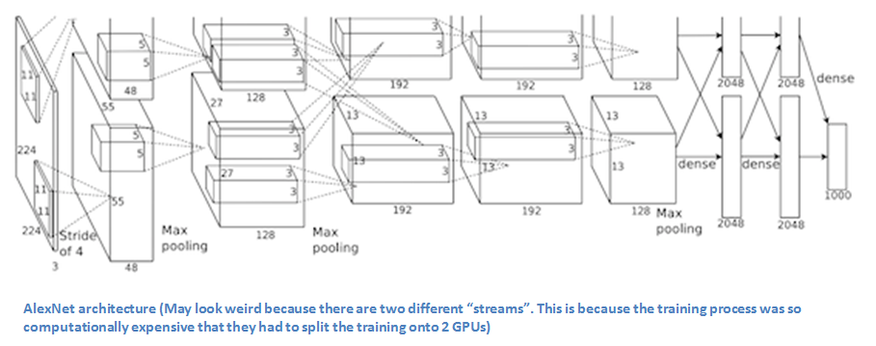
Image Net competition
Classify images into 1000 classes
Human error: 5% - 10%
2012 AlexNet (16.2%)
Trained the network on ImageNet data, which contained over 15 million annotated images
Used ReLU for the nonlinearity functions
Used data augmentation
Implemented dropout layers
Trained on two GTX 580 GPUs for five to six days.

Slide 4
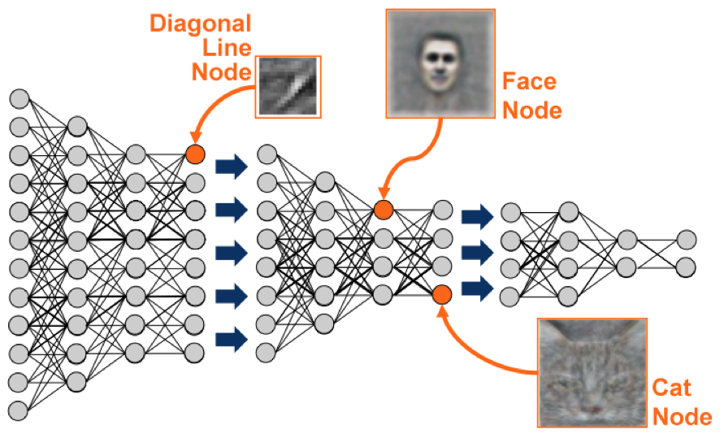
Image Net competition
Classify images into 1000 classes
Human error: 5% - 10%
2012 AlexNet (16.2%)
2013 ZF Net (11.2%) (Matthew Zeiler and Rob Fergus )
Very similar architecture to AlexNet,
Trained on only 1.3 million images.
Trained on a GTX 580 GPU for twelve days.
Developed a visualization technique named Deconvolutional Network, which helps to examine different feature activations and their relation to the input space. Called “deconvnet” because it maps features to pixels (the opposite of what a convolutional layer does).

Slide 5
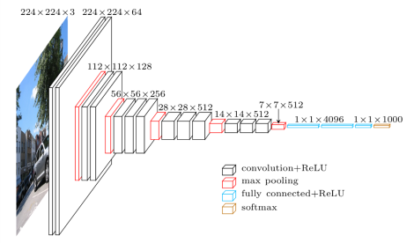
Image Net competition
Classify images into 1000 classes
Human error: 5% - 10%
2012 AlexNet (16.2%)
2013 ZF Net (11.2%)
2014 GoogLeNet (6.7%)
2014 VGG Net (7.3%)
The use of only 3x3 sized filters
Size of input volumes at each layer decrease
They used many layers
Trained on 4 Nvidia Titan Black GPUs for two to three weeks.

Slide 6
ImageNet
What did we learn:
Deeper means better
Consecutive layers are responsible for selecting more and more complicated features
We need a lot of computational power
We need millions of images

Slide 7
Transfer learning
Basic problem in classical approach: How to select features?
Consecutive layers are responsible for selecting more and more complicated features

Slide 8
Transfer learning
Consecutive layers are responsible for selecting more and more complicated features
Take the network, which is already trained

Slide 9

Transfer learning
Consecutive layers are responsible for selecting more and more complicated features
Take the network, which is already trained
Cut the last layer(s)

Slide 10

Transfer learning
Consecutive layers are responsible for selecting more and more complicated features
Take the network, which is already trained
Cut the last layer(s)
Add your own layers

Slide 11
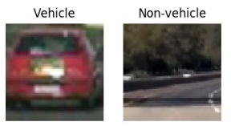
Transfer learning
Consecutive layers are responsible for selecting more and more complicated features
Take the network, which is already trained
Cut the last layer(s)
Add your own layers
Freeze everything else, and train your layers

Slide 12
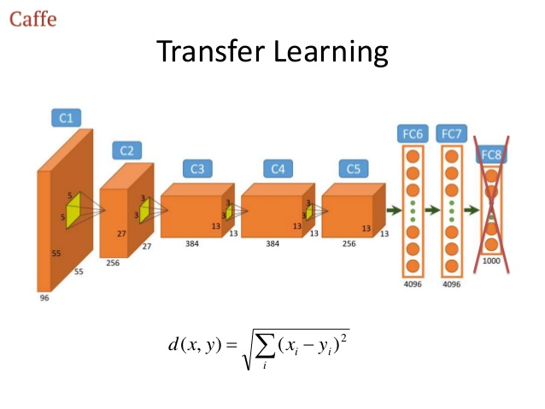
Fine Tuning
* From https://www.slideshare.net/AndrKarpitenko/practical-deep-learning

Slide 13
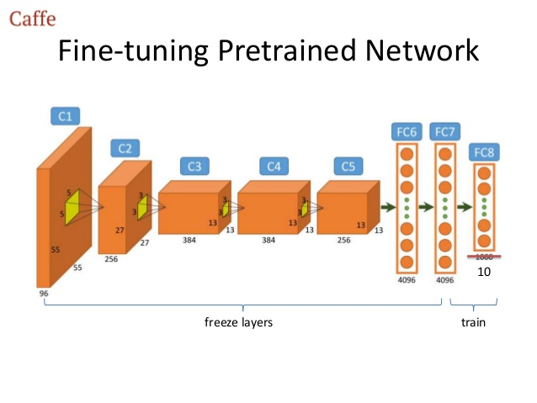
Fine Tuning
* From https://www.slideshare.net/AndrKarpitenko/practical-deep-learning

Slide 14

Fine Tuning
* From https://www.slideshare.net/AndrKarpitenko/practical-deep-learning

Slide 15
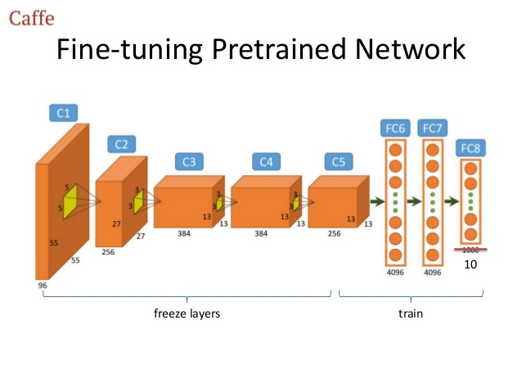
Fine Tuning
* From https://www.slideshare.net/AndrKarpitenko/practical-deep-learning

Slide 16
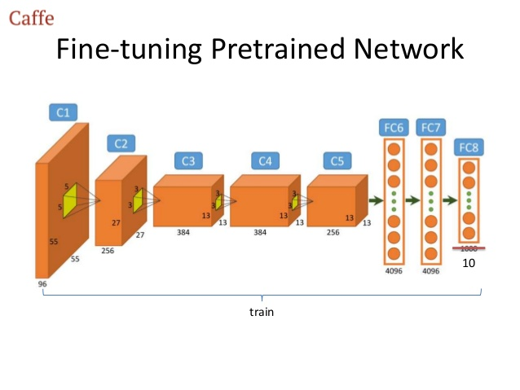
Fine Tuning
* From https://www.slideshare.net/AndrKarpitenko/practical-deep-learning

Slide 17
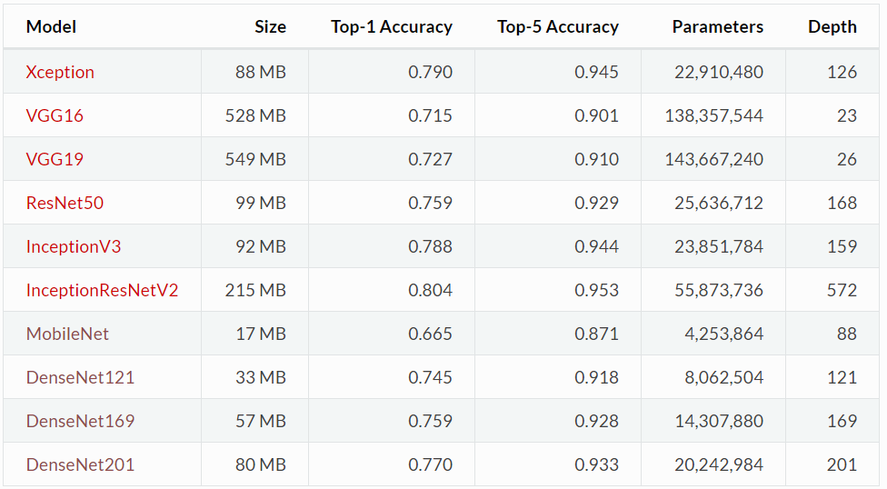
Transfer Learning in Keras
https://keras.io/applications/

Slide 18
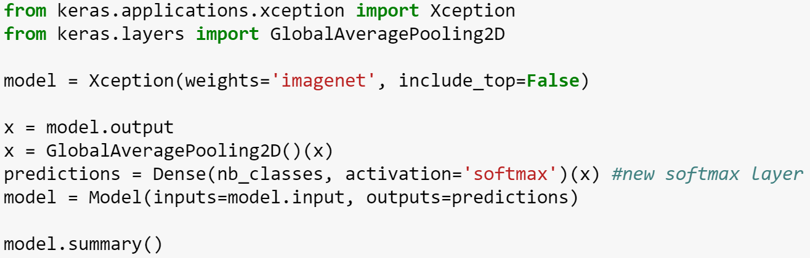
Transfer Learning in Keras
Let’s create the model first

Slide 19
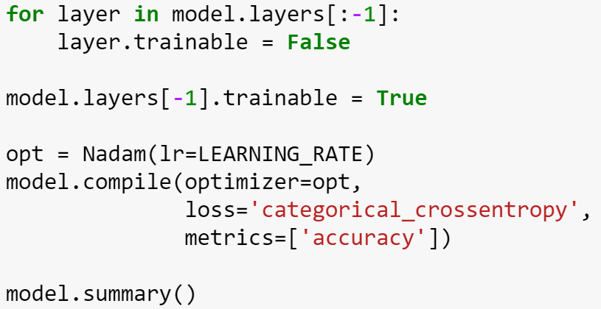
Transfer Learning in Keras
Setup the model for transfer learning

Slide 20
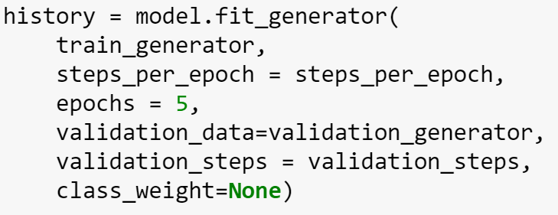
Transfer Learning in Keras
Now we may train

Slide 21
Thank you Q & A

